Slide 1
Properties of Waves (Part 1)
MC Textbook Chp 13, pg 255-272
GLM Chp 12

Slide 2
Contents
Introduction to Waves
Transverse Waves
Equation for Wave Speed
Predicting Direction of Particle Movement
Wavefronts

Slide 3
What is a Wave?
A wave is easy to see and to understand, but much harder to explain or to describe
Waves have something to do with the transfer of energy
Waves also have something to do with vibrations
At your level, all waves are periodic, i.e. the vibrations are continuous and regular

Slide 4
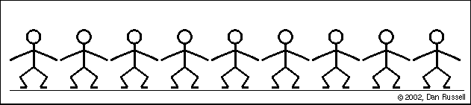
Kallang Wave
What happens when people in the national stadium is doing a Kallang Wave?
Observe:
  what direction is the wave travelling?
  what direction is each person moving?

Slide 5
Wave Motion
You have noticed that in wave travels from left to right.
This is called the direction of propagation.
The direction of propagation is also the direction of transfer of energy
You have noticed that the individual humans move up and down.
This is called the direction of displacement
Even though the wave moves from left to right, the humans do not.

Slide 6
Wave Applet
https://phet.colorado.edu/en/simulation/wave-on-a-string
This applet simulates waves moving on a string
Just like before, observe the direction of the wave and the motion of vibrating objects
Notice that the direction of the wave is perpendicular to the direction of motion of the vibrating particles
When direction of wave is perpendicular to direction of vibrations, the wave is said to be a transverse wave

Slide 7
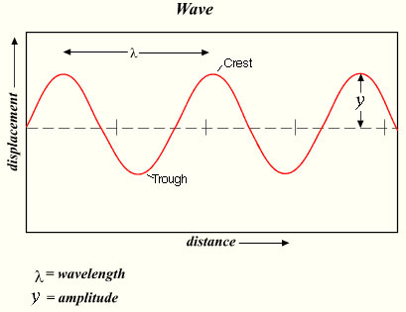
Transverse Wave
Below is a snapshot of a transverse wave in a single instant in time.
Sometimes we call this a “displacement-distance graph” of a wave.

Slide 8
Transverse Wave
Parts of a transverse wave you need to be familiar with
Rest position – where the particles would be if there is no wave
Crest – highest point of a wave. The particle is at the highest displacement at the crest
Trough – lowest point of a wave. The particle is at the lowest displacement at the trough
Amplitude (symbol: A) – the maximum displacement of a point from its rest position
Wavelength (symbol: λ) – the shortest distance between any two points in phase (i.e. one complete waveform)

Slide 10
Transverse Waves
Period (T, units: s) – time taken to produce one complete wave
Frequency (f, units: Hz) – the number of complete waves produced per second
T and f are reciprocal of each other
  T = 1/f
  f = 1/T
Wave Speed (v, units: ms⁻¹) – the distance travelled by a wave per second
v = f λ (Equation for wave speed)
  if λ is in m, and f is in Hz, then v is m s⁻¹
  if λ is in cm, and f is in Hz, then v is cm s⁻¹

Slide 11
Example
A water wave has a period of 5 seconds and a wavelength of 2 metres. What is its wave speed?
Ans:
T = 5 s
f = 1/T = 1/5 = 0.2 Hz
v = f λ
= (0.2)(2)
= 0.400 ms⁻¹ (3sf)

Slide 12
Practice Task
GLM
Pg 199 6(d), 7(a)-(b)

Slide 13
(no time for) Half-Time
Bill Nye - http://www.youtube.com/watch?v=OGyRe_SGnck
Hip-hop Wave Moves:
  Arm Wave - http://www.youtube.com/watch?v=vB8tLNxahTM
  Body Wave - http://www.youtube.com/watch?v=7tLpuEusbQk
  Tracing – http://www.youtube.com/watch?v=swqq7Md5lDA

Slide 14
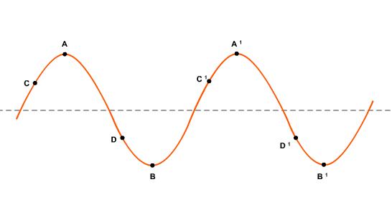
Predicting Motion of Particle
This is a common O and A level question.
Look at particle C, what direction is particle C moving?

Slide 15
Predicting Motion of Particle
Step 1: sketch the same wave a split-second later
Step 2: note whether the particle has moved up or down
note: be extra careful of particles at the crest (A) or at the trough (B). These waves are changing direction, hence they are temporarily at rest.

Slide 16
Exercise
Describe the motion of particles A, C and D.

Slide 17
Wavefronts
The ripple tank is an experiment where shallow water waves are formed in a glass tank, and light is shone through the glass tank to project the image of the waves to the wall (or ceiling)
Video: http://www.youtube.com/watch?v=JXaVmUvwxww
Ripple tanks allow us to visually see wavefronts.

Slide 18
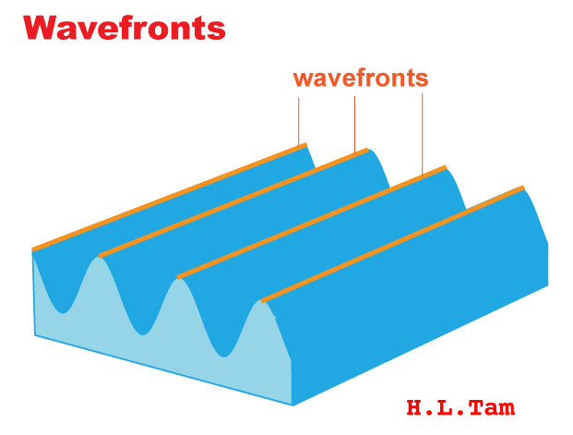
Wavefronts
So far we’ve seen waves from the side-view
Wavefronts are waves seen from the top-view
Imagine a line drawn connecting all the crests of the waves – this line is a wavefront.

Slide 19
Wavefronts
Defn: An imaginary line on a wave that joins all adjacent points that are in phase
Wavefronts also move in the same direction of the wave
Speed of wavefronts moving = wave speed
Distance between each wavefront = wavelength

Slide 20
Summary
6 Definitions
  Amplitude, Wavelength, Period, Frequency, Wave Speed, Wavefront
2 Equations
  T = 1/f
  v = fλ

Slide 21
Summary
Wave motion = transfer of energy without transfer of matter
Interpret and label parts of a wave when given a displacement-distance graph
Predict movement of particle
Interpret wavefronts

Slide 22
Properties of Waves (Part 2)
Textbook Chp 13, pg 255-272

Slide 23
Recall
When direction of wave and direction of vibration is perpendicular to each other, the wave is called a transverse wave
There are two types of waves:
  Transverse Waves
  Longitudinal Waves
A longitudinal wave is when the wave direction and vibration direction are parallel to each other

Slide 24

Slinky Demo
Notes:
Slinky demo is to show difference between transverse and longitudinal waves

Slide 25
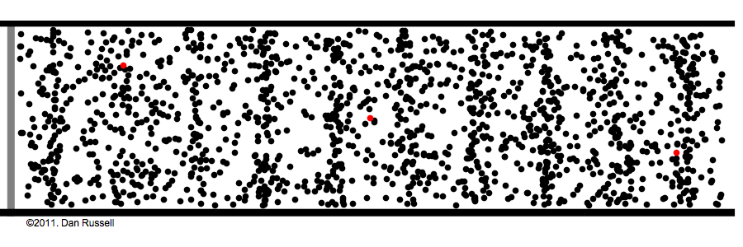
Longitudinal Wave
Look at the animated gif below
Observe the direction of the wave
Observe the movement of the red particle

Slide 26
Longitudinal Wave
The wave moves from left to right
The particle vibrates left and right
The direction of the wave is parallel to the direction of vibration of the particles
Important note: even though the direction is parallel, the particles DO NOT travel along with the wave. They are still vibrating around fixed position.

Slide 27
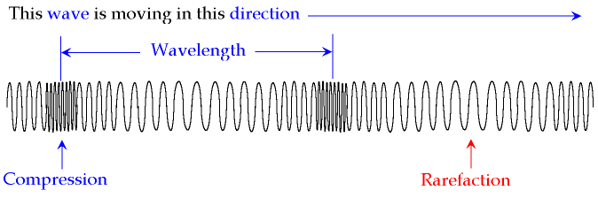
Parts of Longitudinal Waves
A transverse wave has crests and troughs
A longitudinal wave has compressions and rarefactions
A wavelength is measured from compression to compression (or rarefaction to rarefaction)

Slide 28
Parts of Longitudinal Waves
Just like a transverse wave, longitudinal waves have period, frequency, wavelength, wave speed and they obey the equation v = f λ
Just like in a transverse wave, the amplitude of a longitudinal wave is the largest distance a single particle travels measured from its rest position. It is difficult to see this is a “snap shot” of a longitudinal wave.

Slide 29
Half-Time
Water Waves in Zero Gravity http://www.youtube.com/watch?v=zaHLwla2WiI
3 kinds of Seismic Waves http://www.youtube.com/watch?v=T0AEtX-uPLA

Slide 30
Examples of Transverse & Longitudinal Waves
Transverse Waves | Longitudinal Waves
Electromagnetic (EM) Waves (Chp 14) | Sound Waves (Chp 15)
Surface Water Waves | Seismic Waves (Earthquake waves)
Waves on a String | Matter waves (not in syllabus)

Slide 31
Comparison between Transverse and Longitudinal Waves
Similarities:
Both transfer energy without transferring matter (the particles do not move along with the wave)
Both require vibrations
Both have amplitude, wavelength, wave speed, period, frequency and obey the equation v = f λ
Longitudinal waves can also be represented using wavefronts (represent compressions instead of crests)

Slide 32
Comparison between Transverse and Longitudinal Waves
Differences:
Transverse Waves | Longitudinal Waves
Wave direction is perpendicular to vibration direction | Wave direction is parallel to vibration direction
Crests and Troughs | Compressions and Rarefactions
Surface Water Waves, Waves on a string, EM Waves | Sound waves, seismic waves

Slide 33
Summary
Longitudinal Waves are waves direction of wave is parallel to direction of vibrations
Compressions and Rarefactions
Examples of Transverse and Longitudinal Waves
Compare and contrast between transverse and longitudinal waves

Slide 34
Assignment 13
TYS Topic 12
Paper 1 Qn 2, 3, 5, 7, 8, 11
Paper 2 Qn 5

